Slide 1

Distributed Vision-Based Target Tracking Control Using Multiple Mobile Robots
Department of Electrical and Computer Engineering
Bradley University
5/1/2017
Anthony Le and Ryan Clue
Advisors: Drs. Jing Wang and In Soo Ahn
Notes:
Add Page number
Add date

Slide 2
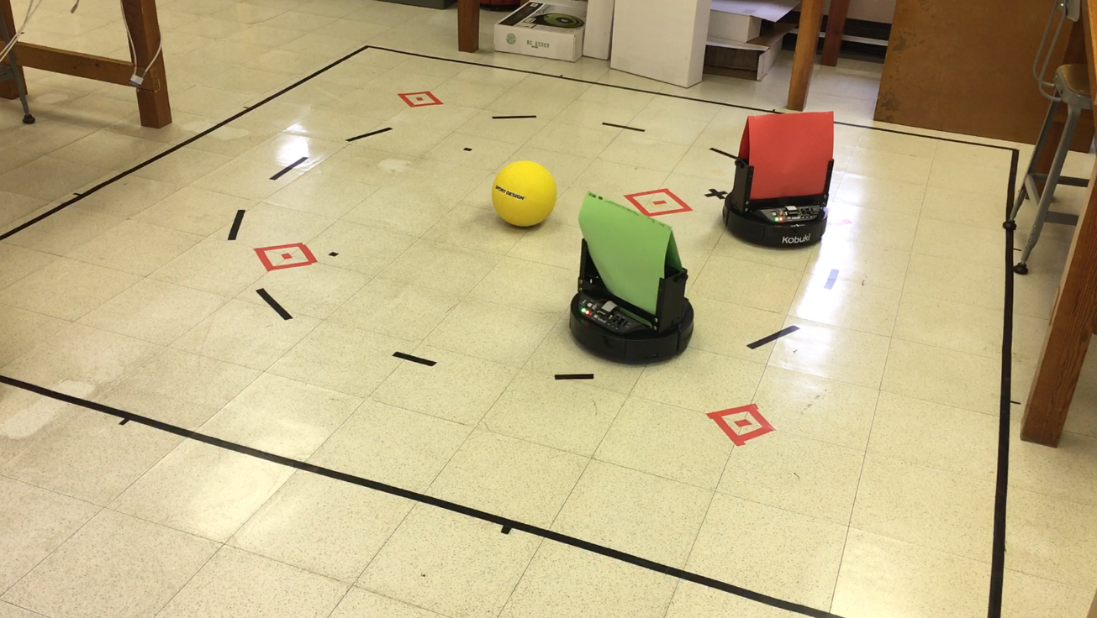
Outline
Introduction
Overview of QBot2
Control Design
Target Identification
Control
Integration
Experimental Results
Conclusions

Slide 3
Introduction

Slide 4
Introduction
Coordination control of multiple robots
Military and civilian applications
Environmental monitoring, threat/obstacle avoidance, search & rescue
Notes:
Bullet points, images

Slide 5
Motivation
In the study of distributed control, one of the fundamental problems is how to make a group of robots maintain certain geometric formation pattern while tracking a target.
Local sensing information exchange among robots is the key in the design of distributed control.
Notes:
Short bullets, text too small
Only need keywords or short phrases

Slide 6
Motivation
Vision sensors have been used in the localization, navigation, and control of the individual robot.
The use of vision sensors for distributed control of multiple robots should be studied.
Notes:
Short bullets, text too small
Only need keywords or short phrases

Slide 7
Related Work
Peter Corke, Robotics, Vision and Control and MATLAB vision control toolbox
2016 Senior Project: Cooperative Control of Heterogeneous Mobile Robots Network
Franchi, Stegagno, and Oriolo, Decentralized multi-robot encirclement of a 3D target with guaranteed collision avoidance. Feb 2016.
Notes:
Not same as references, ALSO introduce work briefly

Slide 8
Objective
Design a distributed vision-based target tracking control algorithm for multiple mobile robots
To achieve the above objective, the research tasks include:
Target identification based on RGB image
Target tracking algorithm based on robot model linearization
Design leader-follower formation control algorithm
Coordinate target identification module and target control module using Stateflow

Slide 9
Overview of QBot2

Slide 10
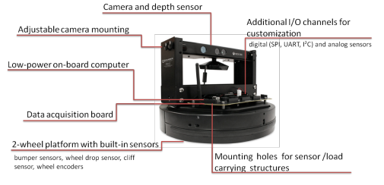
QBot2 Hardware

Slide 11
QBot2 Hardware
Differential drive robot base has a maximum speed of 0.7m/s.
Color camera properties
640x480 Resolution
57°x43° Field-of-View
Red, Green, Blue Color Channels with 8-bit Depth
Infrared Camera Properties
640x480 Resolution
52.5°x41° Field-of-View
0.5m to 6m Depth Estimation (using IR emitter) with 11-bit Depth

Slide 12
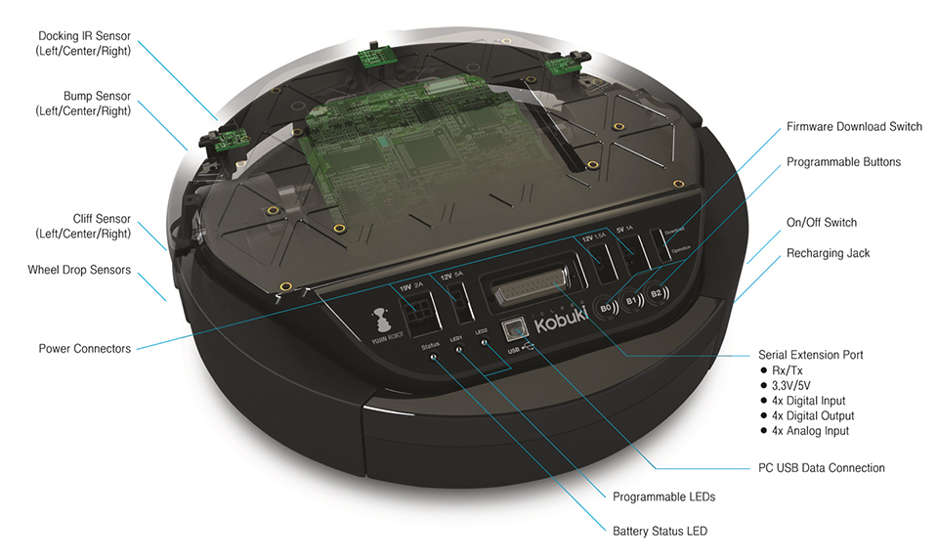
Robot Platform

Slide 13
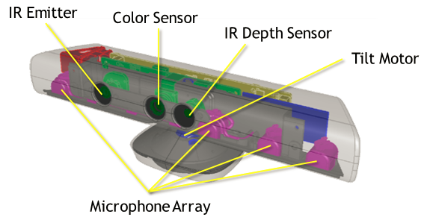
Kinect Camera

Slide 14
Camera Specifications
 | RGB | Infrared
Field of View | 43° vertical x 57° horizontal | 41° vertical x 52.5° horizontal
Max. Frame Rate | 30 fps (or 9 fps) | 30 fps
Max. Image Resolution | 640x480 (or 1280x1024) | 640 x 480
Image Bit Depth | 8 bit color channels | 11 bits
Min/Max Functional Range | N/A | ~0.5m / ~5m

Slide 15
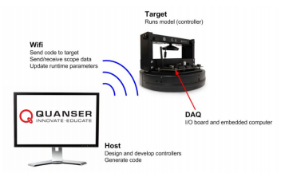
QBot2 Software
The target computer is connected wirelessly with the host computer on which the SIMULINK model is running.
The control algorithms are developed in MATLAB/SIMULINK with QUARC on the host computer.
The control models are cross-compiled and downloaded to the target computer.

Slide 16
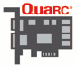
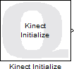
Matlab Interface: Initialization Blocks
HIL Initialization
Targets a specific Hardware-in-the-Loop(HIL) board type
Allows cross-compilation of Matlab code for the deployment platform
Kinect Initialization
Required to use Kinect sensors
Outputs current state of the associated Kinect device

Slide 17
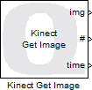
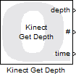
Matlab Interface: Image Retrieval
Kinect Get Image
Acquires either RGB or IR image
Stores image in Qbot2’s memory
Kinect Get Depth
Provides image of blobs with associated depth values
Utilizes Kinect’s capability to process IR image
Output values represent Cartesian distance in millimeters
Output type is 2D array of uint16

Slide 18
QUARC Environment Setup
Ad-hoc setting for windows 10
Set Fixed-step size (fundamental sample time) located in Quarc\Options\Solver
This affects how frequently the Quarc interface samples the Matlab model for use by the DuoVero computer
The computer can only reliably respond to the Quarc interface at 30Hz or less (default value is 1000Hz) due to image processing.
In our project, the fundamental sample time is set to 0.1 seconds.
netsh wlan set profileparameter MY_SSID connectiontype=ibss connectionmode=manual
netsh wlan connect MY_SSID

Slide 19
Control Design

Slide 20
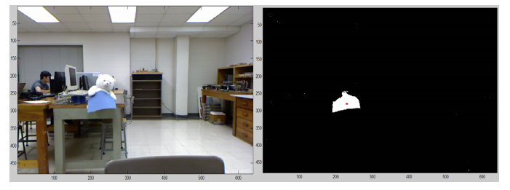
Target Identification
RGB image and depth image are acquired via Get Image/Depth for target/robot identification.
Image thresholding and blob detection algorithms are used in image processing.

Slide 21
Blob Detection
Image Thresholding
Isolate sections of an image by eliminating portions of the image whose values (RGB or IR) do not fall within a particular set of constraints
Simplest method of image processing for RGB images
Blob Detection
Accuracy entirely dependent on thresholding result

Slide 22
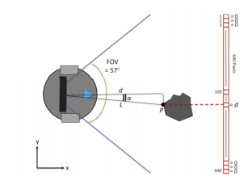
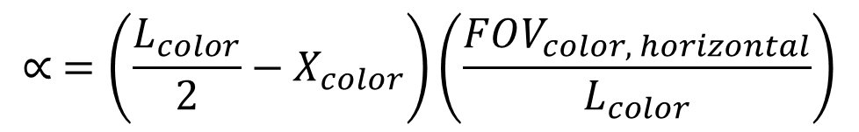
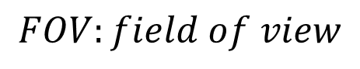
Target Localization
$$∝ =\left(\frac{L_{color}}{2}−X_{color}\right)\left(\frac{FOV_{color, horizontal}}{L_{color}}\right)$$
$$FOV:field of view$$

Slide 23
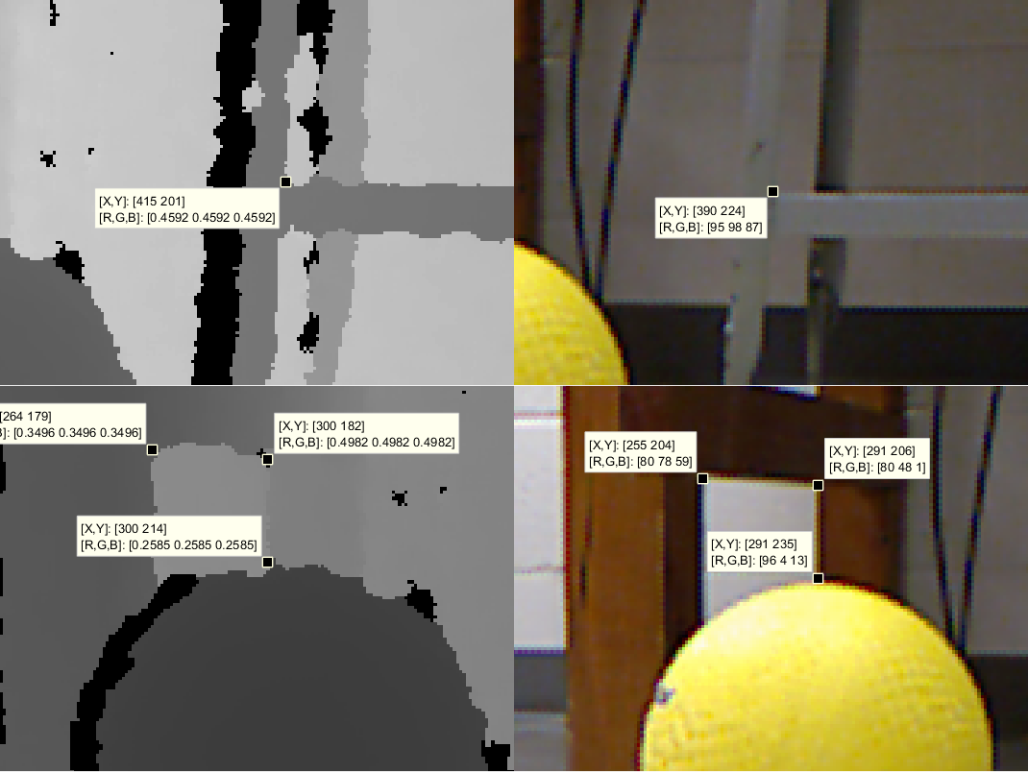
Target Localization

Slide 24
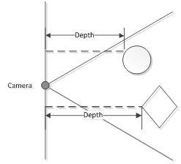
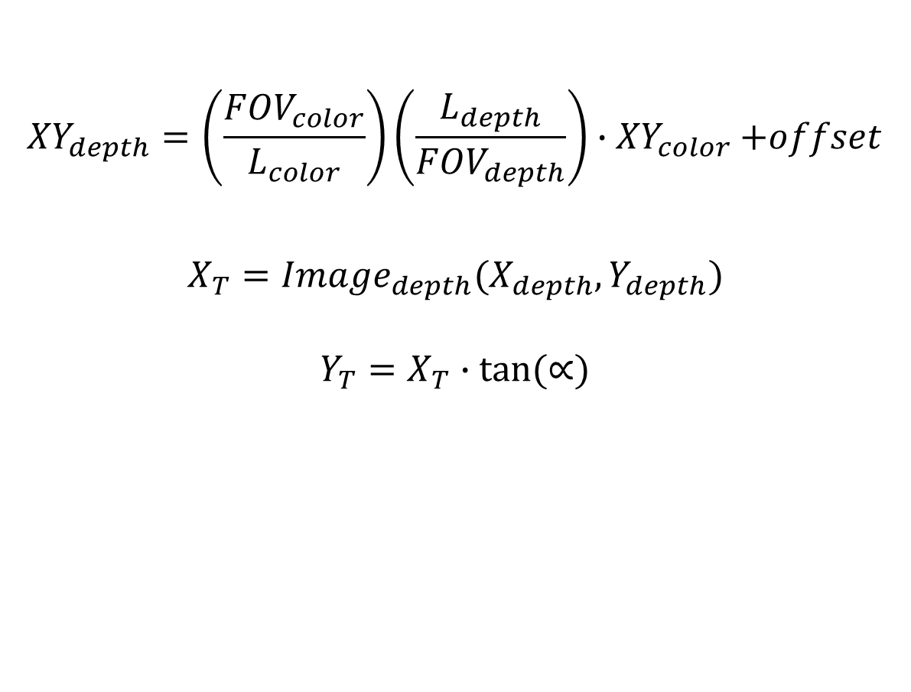
Target Localization
$${XY}_{depth}=\left(\frac{{FOV}_{color}}{L_{color}}\right)\left(\frac{L_{depth}}{{FOV}_{depth}}\right){∙XY}_{color}+offset$$
$$X_{T}={Image}_{depth}(X_{depth},Y_{depth})$$
$$Y_{T}=X_{T}∙tan⁡(∝)$$

Slide 25
Alternative Design
Advantages of Color Thresholding
Low processor resource requirements
Disadvantages of Color Thresholding
White balancing
Differences in lighting will drastically affect results
Any source of outside light will require frequent threshold adjustments
Notes:
Add one page before talking about the problems with color thresholding.
Also why these alternatives were not used

Slide 26
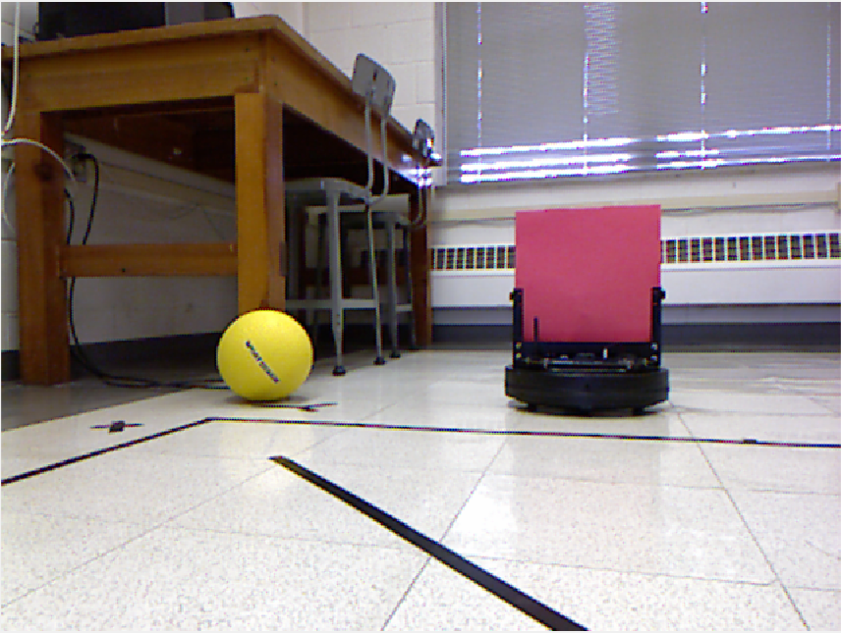
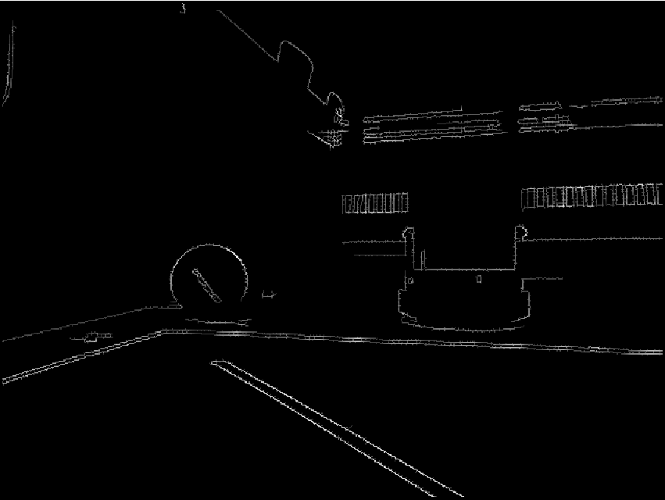
Shape Detection

Slide 27
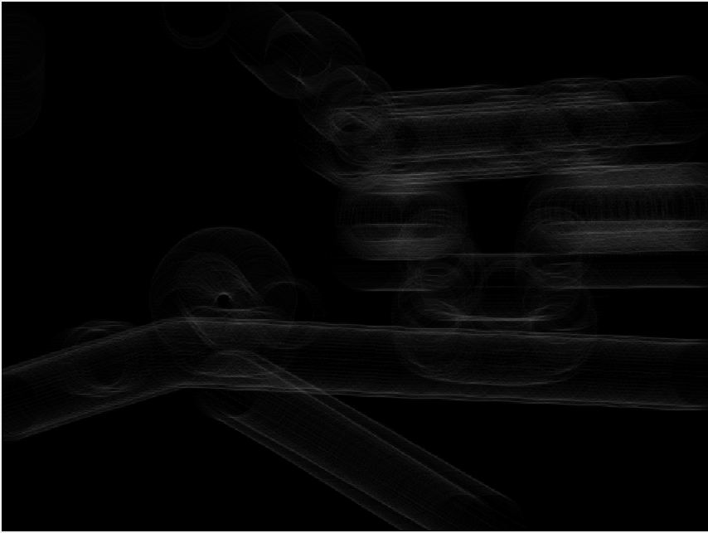
Hough Transform

Slide 28
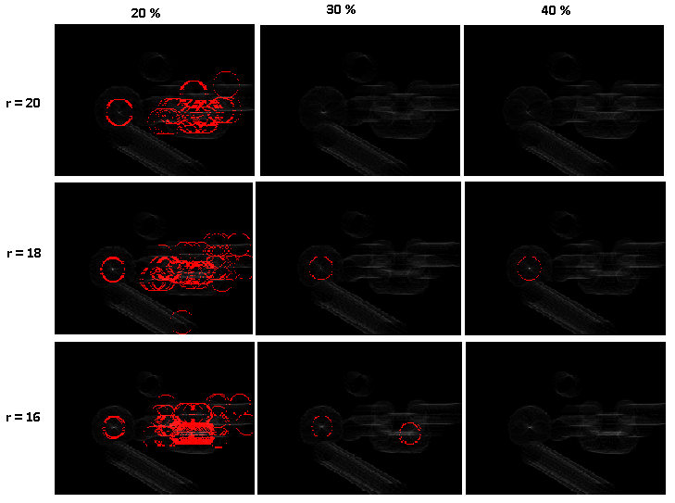
Circle-Hough Transform

Slide 29
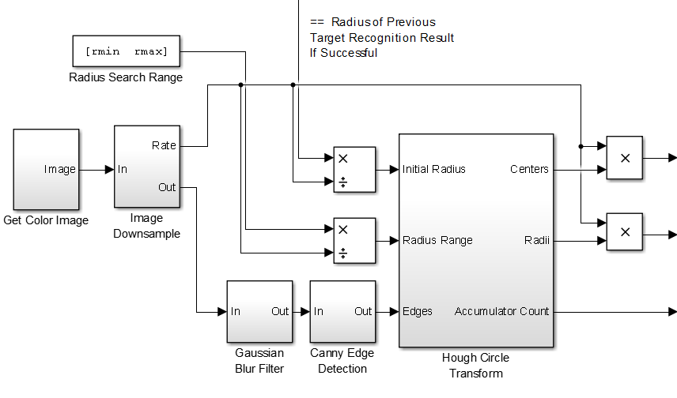
Hough Transform

Slide 30
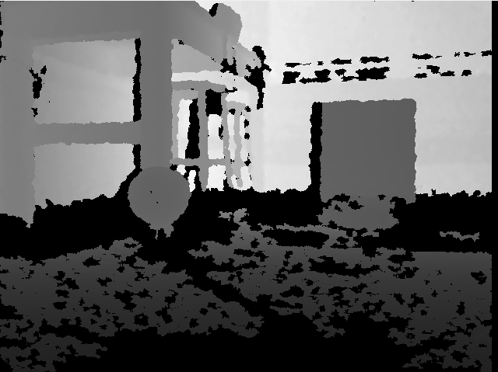
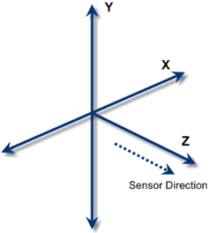
Background Subtraction and Floor Determination

Slide 31
Design of Control Modules
Depending on whether the robot is following a target or leader robots, two separate control modules are used
Both modules use X-Y values from the converted image of the image processing module.

Slide 32
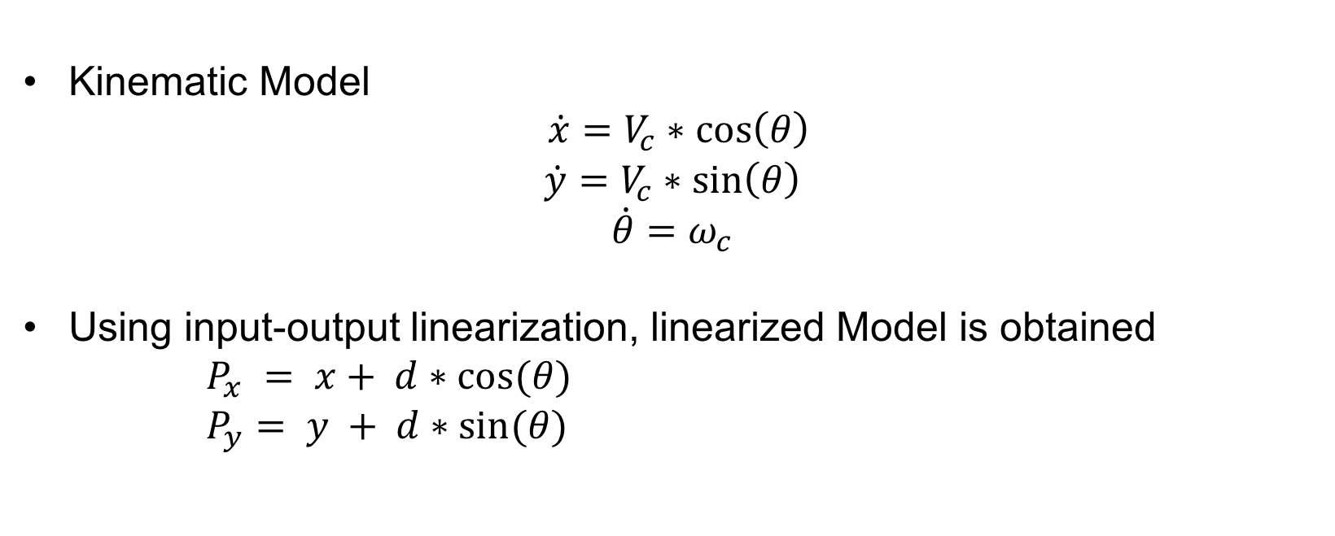

Robot Model
Kinematic Model
$\dot{x}=V_{c}∗\cos\left(θ\right)$
$$\dot{y}=V_{c}∗\sin\left(θ\right)$$
$$\dot{θ}=ω_{c}$$
Using input-output linearization, linearized Model is obtained
$P_{x} = x+ d∗cos(θ)$
$P_{y}= y + d∗sin(θ)$
$$\dot{P_{x}}= U_{x}$$
$$\dot{P_{y}}=U_{y}$$

Slide 33
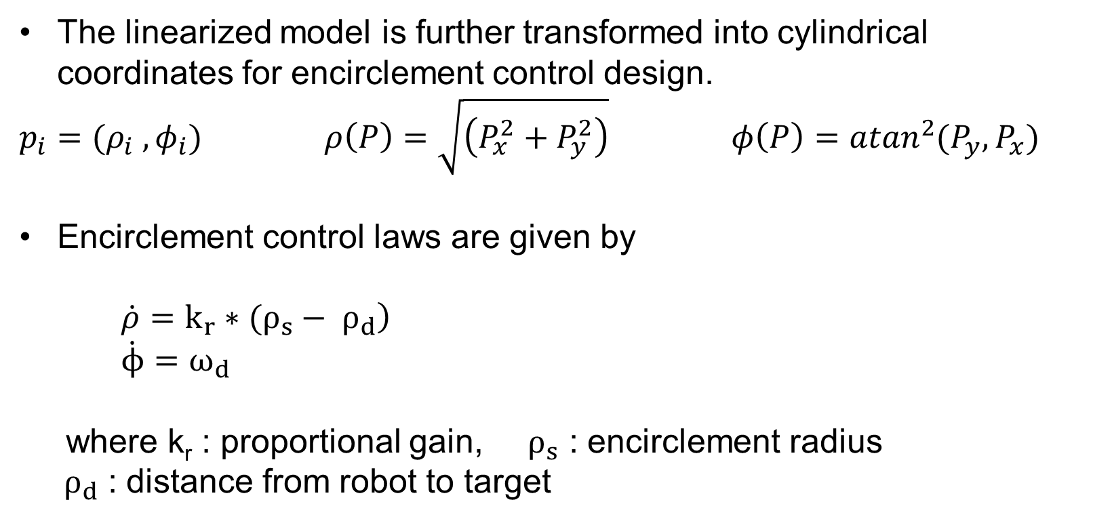
Target Encirclement Control
The linearized model is further transformed into cylindrical coordinates for encirclement control design.
$p_{i}={(ρ}_{i} , φ_{i})$ $ρ\left(P\right)=\sqrt{\left(P_{x}^{2}+P_{y}^{2}\right)}$ $φ\left(P\right)={atan}^{2}{{(P}_{y},P_{x}) }$
Encirclement control laws are given by
$\left.\dot{ρ}=k_{r}∗(ρ_{s}− ρ_{d}\right)$
$\dot{ϕ}=ω_{d}$
where k_{r} : proportional gain, $ρ_{s}$ : encirclement radius
${ ρ}_{d}$ : distance from robot to target

Slide 34
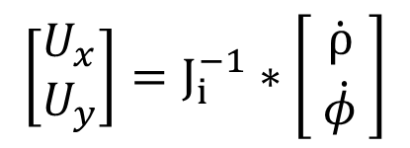
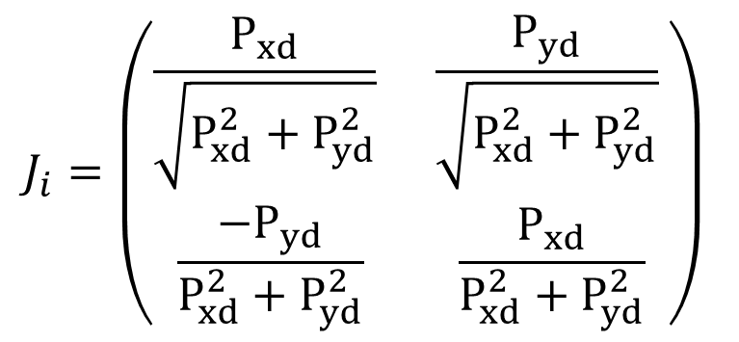
Target Encirclement Control
The inverse of the Jacobian matrix is used to determine $U_{x}$ and $U_{y}$
$$J_{i}=\left(\begin{matrix}\frac{P_{xd}}{\sqrt{P_{xd}^{2}+P_{yd}^{2}}} & \frac{P_{yd}}{\sqrt{P_{xd}^{2}+P_{yd}^{2}}} \\ \frac{{−P}_{yd}}{P_{xd}^{2}+P_{yd}^{2}} & \frac{P_{xd}}{P_{xd}^{2}+P_{yd}^{2}}\end{matrix}\right)$$
$$\left[\begin{aligned}U_{x} \\ U_{y}\end{aligned}\right]=J_{i}^{−1}∗\left[\begin{aligned}\dot{ρ} \\ \dot{φ} \end{aligned}\right]$$
where
Notes:
Robot model -> linearize -> convert linear to polar ->
Partial rho/px partial phi/px, rho/py phi/py (check this )

Slide 35
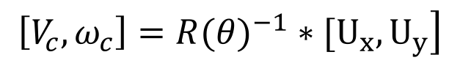
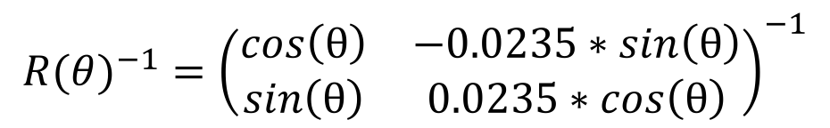
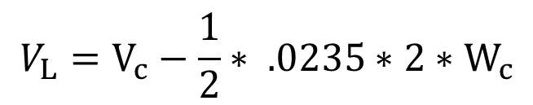
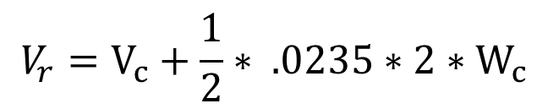
Target Encirclement Control
$U_{x}$ and $U_{y}$ are then converted to V_{c} and $ω_{c}$
$${R(θ)}^{−1}={\left(\begin{matrix}\cos\left(θ\right) & −0.0235∗\sin\left(θ\right) \\ \sin\left(θ\right) & 0.0235∗\cos\left(θ\right)\end{matrix}\right)}^{−1}$$
$$\left.\left[V_{c}, ω_{c}\right]={R(θ)}^{−1}∗[U_{x}, U_{y}\right]$$
V_{c} and $ω_{c}$are converted to V_{r} and V_{L}
$$V_{L}=V_{c}−\frac{1}{2}∗ .0235∗2∗W_{c}$$
$$V_{r}=V_{c}+\frac{1}{2}∗ .0235∗2∗W_{c}$$
Notes:
Dimensions not right (fix the dimension here, should be col vector) be consistent in the equations (Vc )

Slide 36
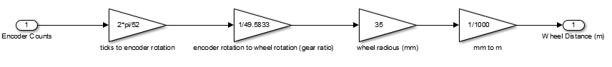
Encoder Transformation

Slide 37
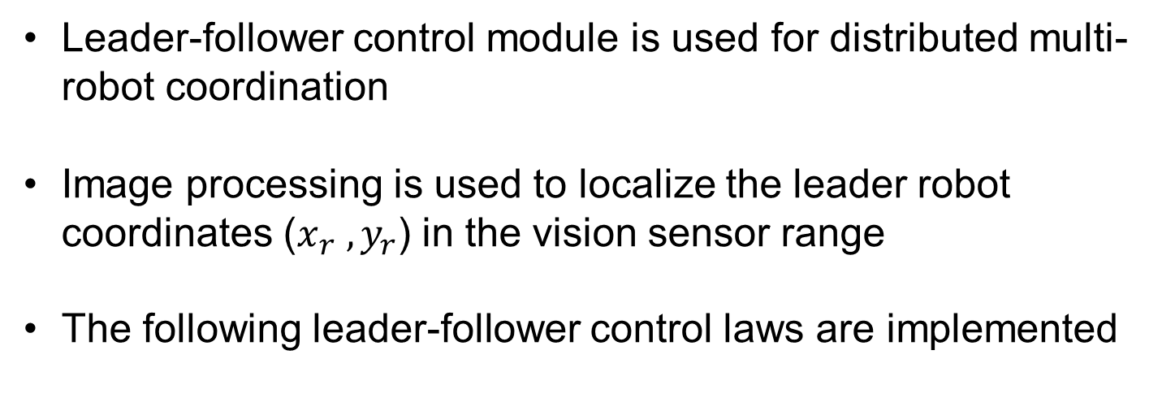
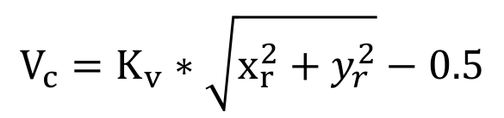
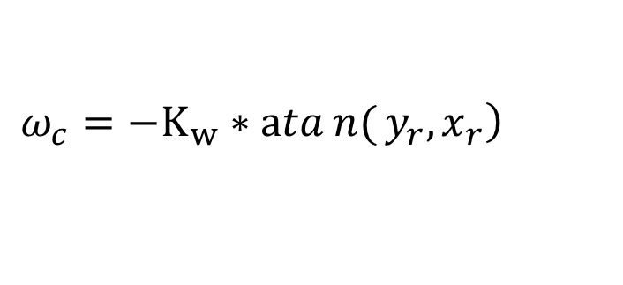
Leader-Follower Control
Leader-follower control module is used for distributed multi-robot coordination
Image processing is used to localize the leader robot coordinates ($x_{r} , y_{r}$) in the vision sensor range
The following leader-follower control laws are implemented
$$V_{c}=K_{v}∗\sqrt{x_{r}^{2}+y_{r}^{2}}−0.5$$
$$\left.ω_{c}=−K_{w}∗atan{(}y_{r},x_{r}\right)$$
where Kv=0.2 and Kw= 0.5. Limits for angular and forward velocity are set to 0.2 m/s
Notes:
Double check atan ( ), It is better to use tan^-1( yr/xr)

Slide 38
Event-based System Control
• Stateflow control is designed to coordinate control modules enabling/disabling Simulink blocks Stages
Step 1: Search for encirclement target or leader robot. If target is not in view, rotate 15° CCW and repeat this step. Otherwise continue to next stage.
Step 2: Switch to encirclement or leader-follower motion controls. If target is no longer in view, stop moving and return to step 1.
Notes:
Add a flow chart

Slide 39
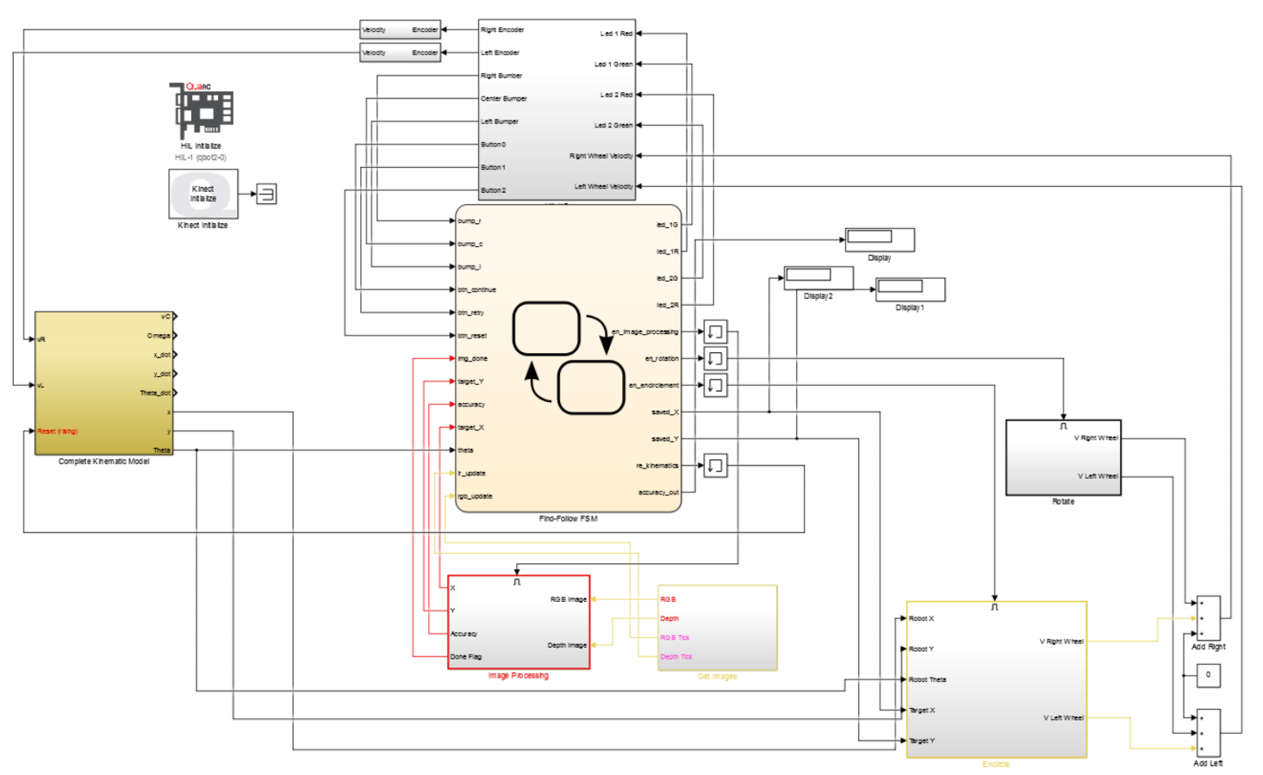
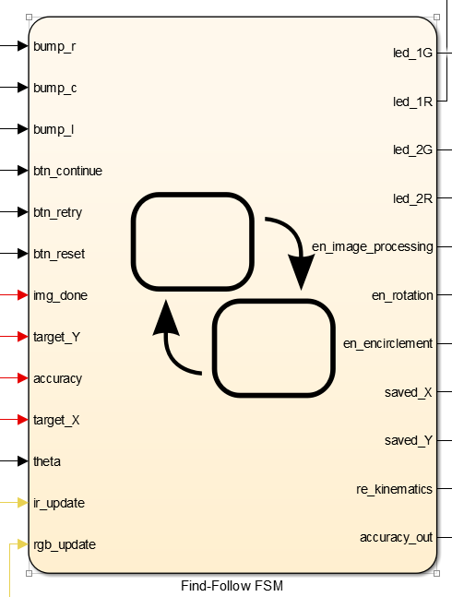
Event-based System Control: Stateflow

Slide 40
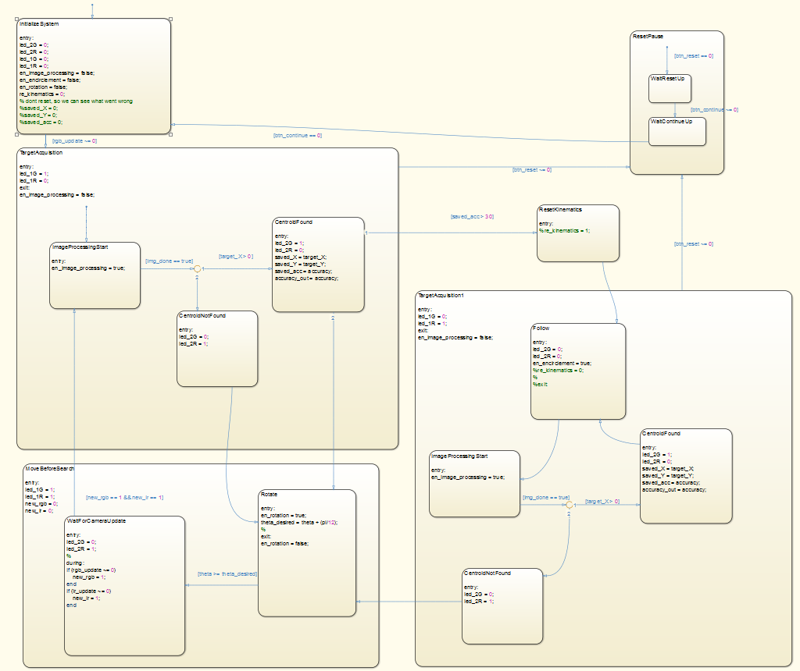
Event-based System Control – Encirclement Control

Slide 41
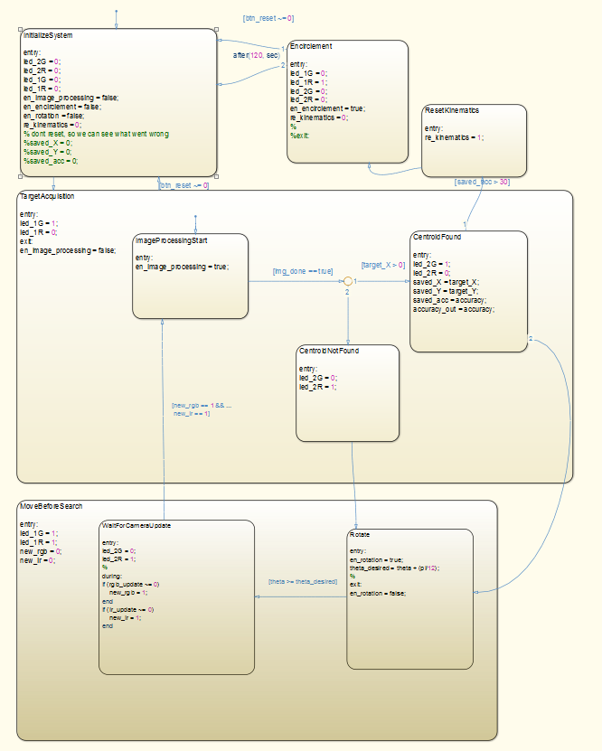
Event-based System Control
Leader-Follower Control
Notes:
Fix the title, - Leader-follower control ( 40 font size)

Slide 42
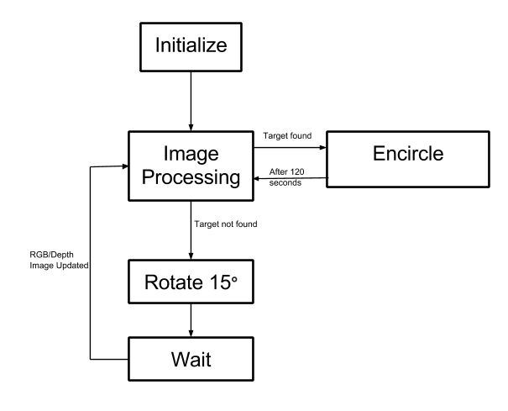
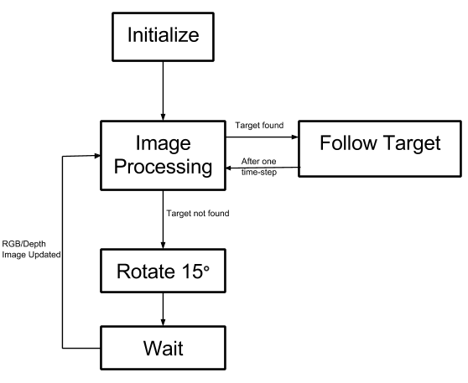
Event-based System Control
Encirclement Control
Leader-Follower Control

Slide 43
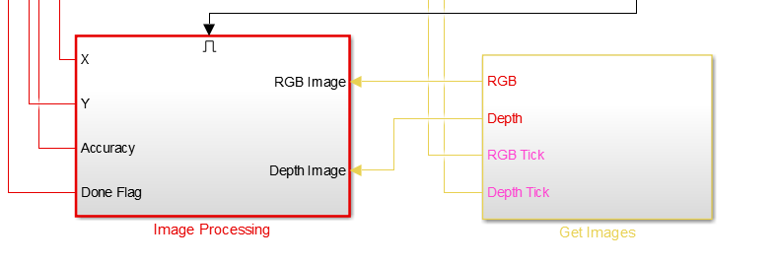
Event-based System Control
Notes:
Add subtitle with font size 40 here
Add arrow and box to highlight the control blocks

Slide 44
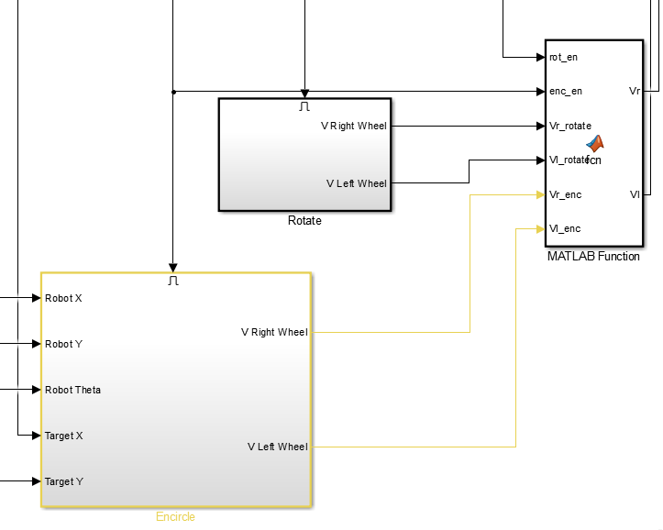
Event-based System Control
Notes:
Add subtitle with font size 40 here
Add arrow and box to highlight the control blocks

Slide 45
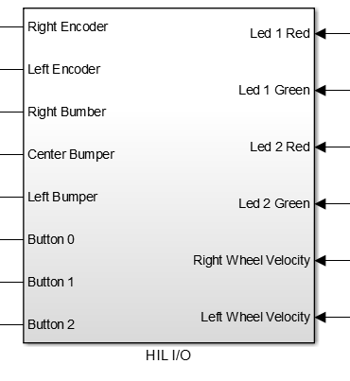
Event-based System Control
Notes:
Add subtitle with font size 40 here
Add arrow and box to highlight the control blocks

Slide 46
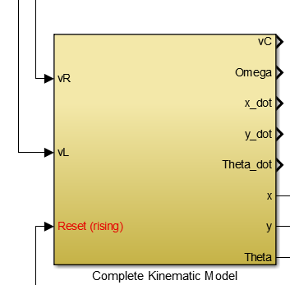
Event-based System Control
Notes:
Add subtitle with font size 40 here
Add arrow and box to highlight the control blocks

Slide 47
Experimental Results

Slide 48
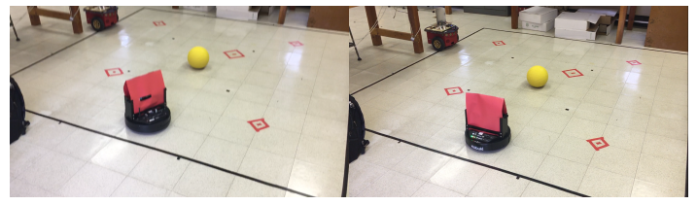
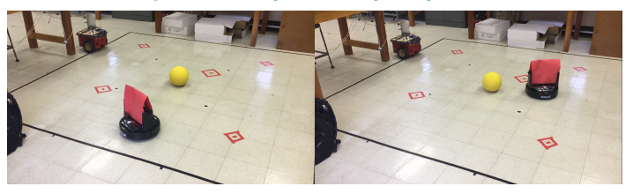
Experimental Results - Encirclement
Notes:
Add video

Slide 49
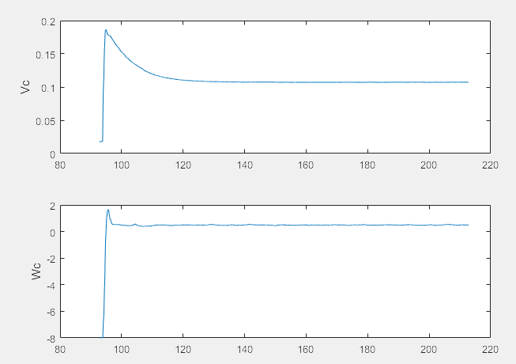
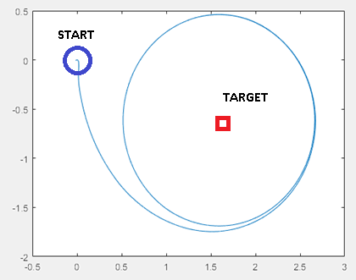
Experimental Results - Encirclement
Phase plot of robot
Forward and Angular Velocities
Notes:
TITLES!
Must add some labels, legends
Add a little bit of context

Slide 50

Experimental Results – Encirclement

Slide 51
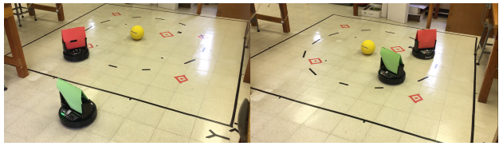
Experimental Results – Leader-Follower

Slide 52
Experimental Results – Leader-Follower

Slide 53


Experimental Results – Leader-Follower
Phase plot of robot
Forward and angular velocities of robot
Notes:
Mark the start in the phase plot

Slide 54
Division of Work
Ryan
Image Processing Module Design
Encirclement Stateflow Control Design
Experimental Testing
Anthony
Image Processing
Control Module Design
Leader-Follower Stateflow Control Design
Experimental Testing
Notes:
Your full name

Slide 55
Conclusions
Work accomplished
A distributed vision-based target tracking control was designed and experimentally validated using mobile robots.
The design was done by combining image processing and control task modules using Stateflow switched control strategies.
Future work
Develop a more effective and robust image processing method
Shape Recognition
Integrate obstacle avoidance function
Conduct experiments using a large group of robots
Notes:
Use encirclement control instead of leader-follower control
Where robots assume other robot’s movement

Slide 56
Notes:
ACK.

Slide 57
References
[1] “Cooperative Control of Heterogenous Mobile Robots Network.” [Online]. Available: http://ee.bradley.edu/projects/proj2016/mrn/. [Accessed: 14-Dec-2016].
[2] A. Franchi, P. Stegagno, and G. Oriolo, “Decentralized Multi-Robot Encirclement of a 3D Target with Guaranteed Collision Avoidance,” Autonomous Robots, vol. 40, no. 2, pp. 245–265, Feb. 2016.
[3] G. Bock, R. Hendrickson, J. Lamkin, B. Dhall, J. Wang, and I. S. Ahn, “Experiments of distributed control for multiple mobile robots with limited sensing/communication capacity,” in 2016 IEEE International Conference on Electro Information Technology (EIT), 2016, pp. 0559–0564.
[4] “Kinect for Windows Sensor Components and Specifications.” [Online]. Available: https://msdn.microsoft.com/en-us/library/jj131033.aspx. [Accessed: 14-Dec-2016].
[5] “Quanser - QBot 2 for QUARC.” [Online]. Available: http://www.quanser.com/products/qbot2. [Accessed: 14-Dec-2016].
[6] P. Corke, Robotics, Vision and Control - Fundamental Algorithms in MATLAB .
Notes:
Follow structure for citations like in report
Also peter corke’s book and toolbox

Slide 58
Q&A
Thanks!

